Slide 1

Customer Segmentation with Pyspark
KRISHNA CHAITHANYA REDDY KUNCHAM

Slide 2
Introduction
In today's competitive business world, understanding customers is key. This project focuses on customer segmentation using PySpark, a powerful tool for big data analysis. By dividing customers into groups based on common characteristics, we aim to create personalized marketing strategies. These strategies, tailored to each group's preferences, boost customer engagement and loyalty, helping businesses thrive in the market.

Slide 3
Objectives
1
Customer Segmentation
Implement customer segmentation using PySpark to divide customers into distinct groups based on their behavior, preferences, and characteristics.
2
Data Preprocessing
Utilize data preprocessing techniques to clean and prepare the dataset for analysis, ensuring data quality and accuracy.
3
Exploratory Data Analysis
Apply exploratory data analysis (EDA) to gain insights into customer behavior and identify key features for segmentation.
4
Machine Learning Models
Build machine learning models using PySpark MLlib to perform customer segmentation.
5
Cluster Analysis
Conduct cluster analysis to interpret segmentation results and derive actionable insights for personalized marketing strategies

Slide 4
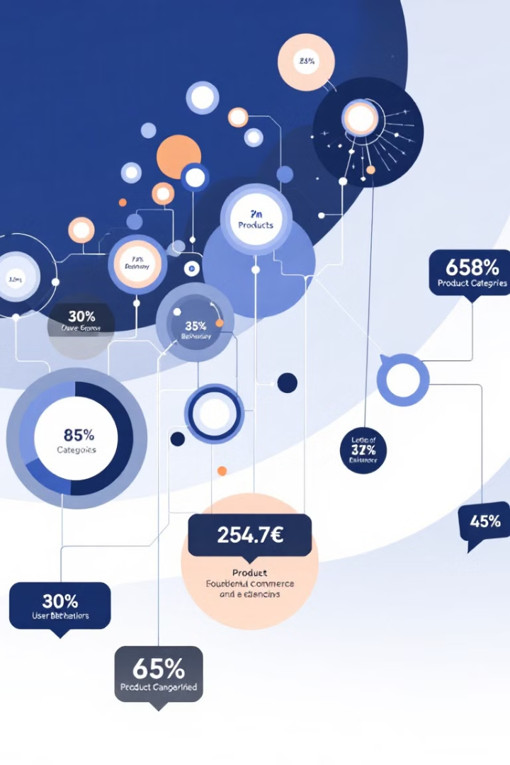
Description of Dataset
Dataset Source
Key Data Fields
Large-scale eCommerce transaction dataset from Kaggle
event_time, event_type
product_id, category_id
brand, price, user_id
Data Challenges
Handling missing values
Processing large-scale data
Identifying meaningful segments

Slide 5
EDA
Analyzed the dataset to understand its structure and contents.
Conducted category-wise and brand-wise analysis to identify popular categories and brands among customers.
Examined user behavior over time to identify seasonal trends or patterns in purchasing behavior.
Calculated the correlation matrix to identify relationships between numeric variables, aiding in understanding feature interactions and potential multicollinearity issues.

Slide 6
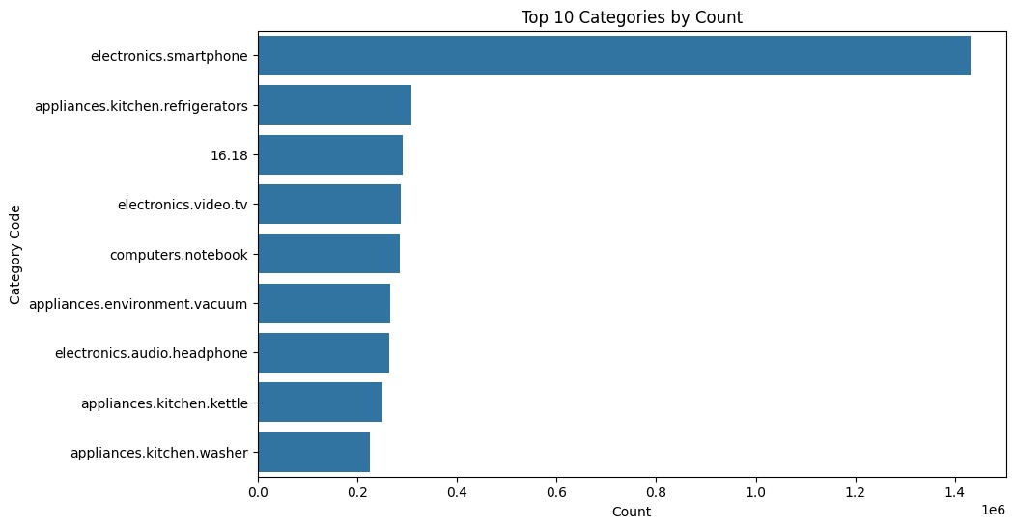
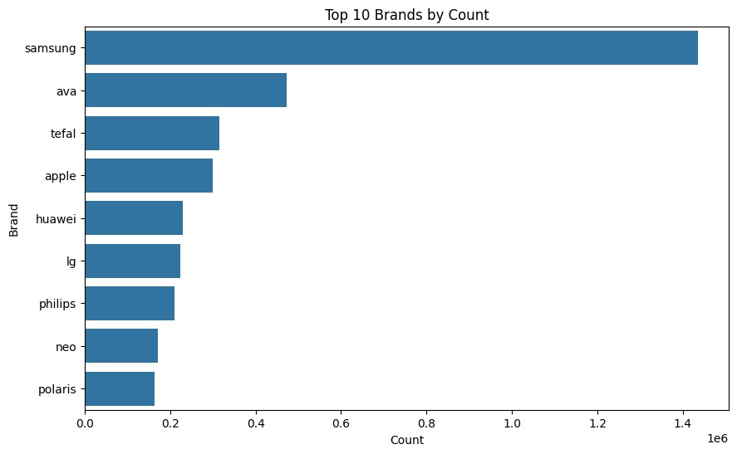
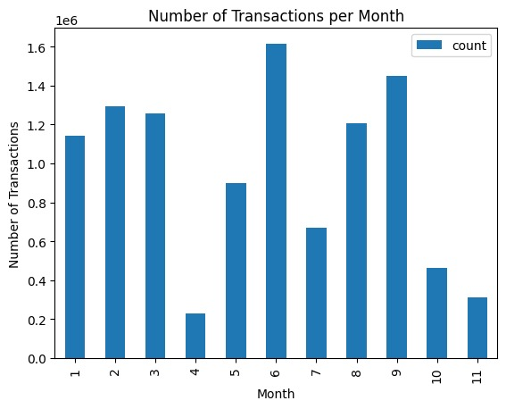
Categorical Analysis
Top 10 categories by count
Top 10 brands by count
Visualization of number of transactions per month

Slide 7
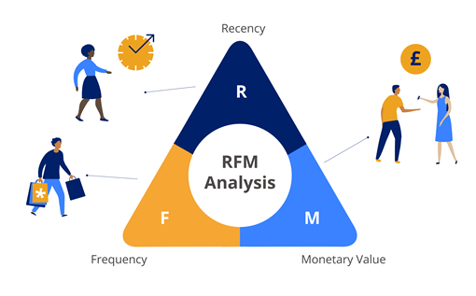

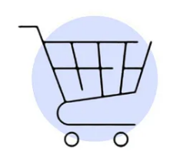
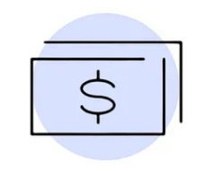
RFM Analysis
RFM Definition
RFM stands for Recency, Frequency, and Monetary Value, a customer segmentation technique widely used in marketing and retail.
It segments customers based on their transaction behavior, focusing on three key metrics:
Recency
Frequency
Monetary Value
How recently a customer made a purchase.
How often a customer makes a purchase.
How much money a customer spends on purchases

Slide 8




RFM Analysis
Customer Segmentation
Targeted Marketing
RFM analysis helps in categorizing customers into distinct segments based on their transaction behavior.
Allows for tailored marketing strategies by addressing the specific needs and preferences of each customer segment.
Improved Engagement
Enhanced Retention
Enables businesses to engage with customers more effectively by delivering personalized experiences and offers.
Identifies high-value customers and facilitates efforts to retain them by offering incentives and personalized services.

Slide 9
RFM Analysis
Recency is computed by subtracting the month_key representing the month of the last purchase from the maximum month value, providing a quantitative measure of the time elapsed since the last customer purchase
Frequency is determined by counting the number of unique order_ids for each user_id, indicating how often a customer makes purchases within a specific time period.
Frequency is determined by counting the number of unique order_ids for each user_id, indicating how often a customer makes purchases within a specific time period.
Merging RFM with Order Frequency and Monetary Value: Combining the RFM DataFrame with the order count and total monetary value DataFrames based on the 'user_id' column to enrich the dataset with additional metrics.
Data Integrity Check: Evaluating the RFM data integrity by counting non-null values in the 'Recency' column and filtering for non-zero recency values to ensure the dataset's completeness and relevance.

Slide 10
Building a Model
Selected relevant features for clustering, including 'Recency', 'Frequency', and 'Monetary Value', crucial for customer segmentation based on their purchasing behavior.
Pipeline Creation: Constructed a data processing pipeline using PySpark ML components, such as VectorAssembler for feature vectorization, StandardScaler for feature scaling, and KMeans for clustering, streamlining the preprocessing and modeling workflow.
Utilized the elbow method to determine the optimal number of clusters (k) for KMeans clustering by plotting the within-cluster sum of squares (WCSS) against different values of k. The point where the decrease in WCSS starts to slow down indicates the optimal number of clusters.

Slide 11
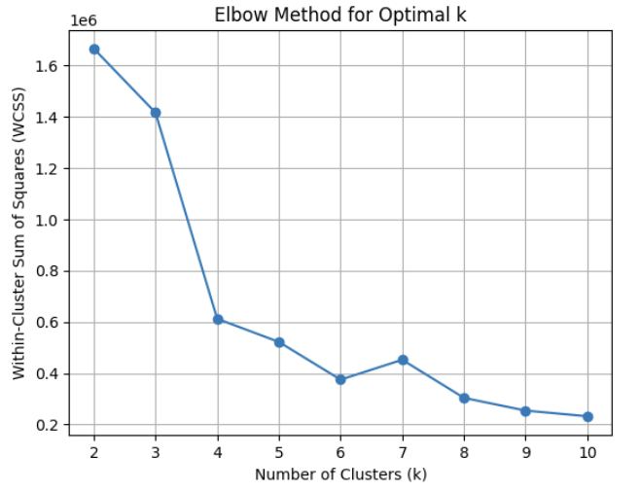
Elbow method for optimal k
KMeans Clustering with k=4: Implemented KMeans clustering with k=4, indicating that the data would be segmented into four distinct clusters based on the features 'Recency', 'Frequency', and 'Monetary Value'.

Slide 12
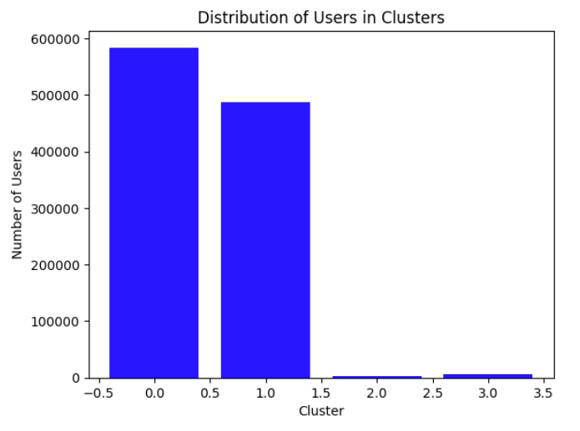
Cluster Visualization
Cluster Visualization: Visualized the distribution of users across clusters using a bar graph, providing insights into the size and distribution of each cluster.

Slide 13
Cluster Analysis and Results
Utilized bar graphs to showcase the average values of the features ('Recency', 'Frequency', 'Monetary') for each cluster. This visualization helps in understanding the characteristics and differences between clusters, aiding in strategic decision-making for targeted marketing and customer engagement.

Slide 14
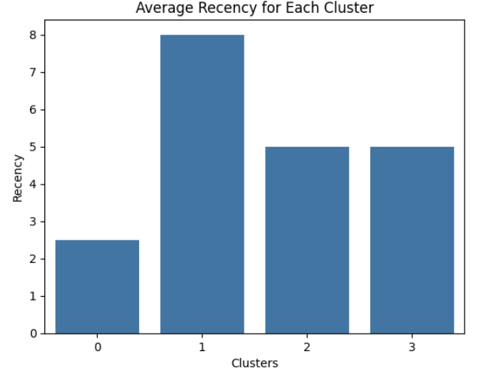
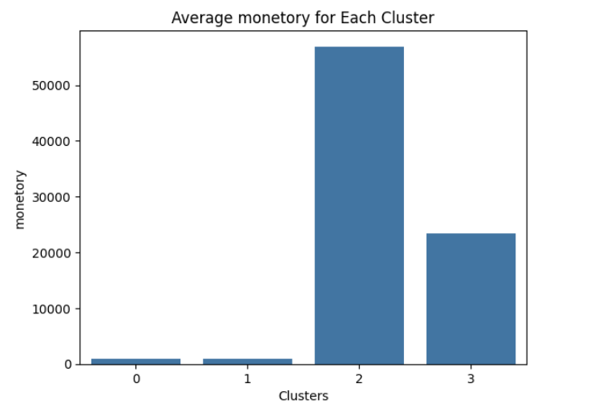
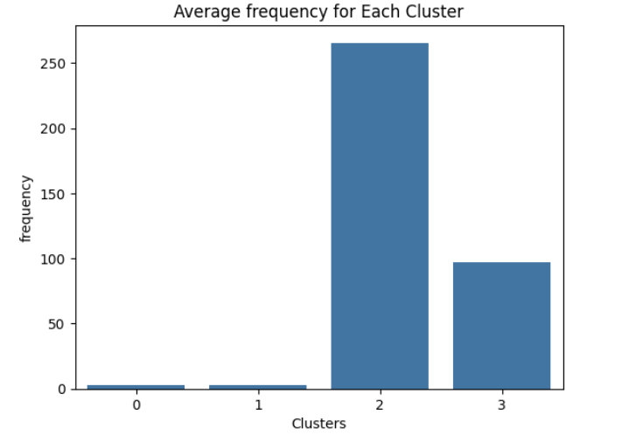

Slide 15
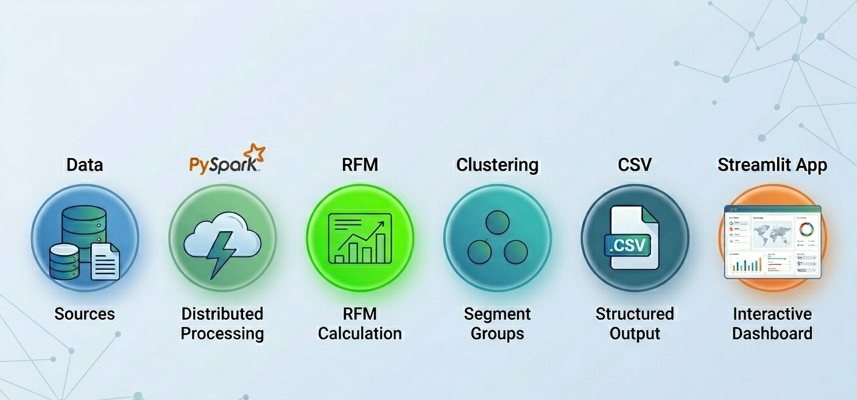
System Architecture / Workflow

Slide 16
Streamlit Application Overview”
Built an interactive dashboard using Streamlit
Allows user to:
Select customer ID
View RFM metrics
View transaction history
Get business recommendations

Slide 17
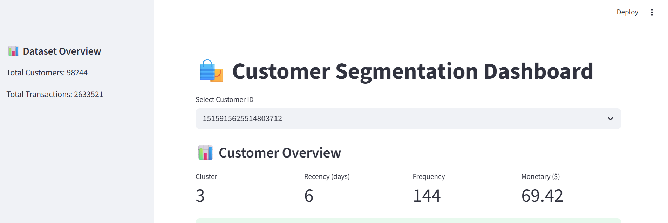
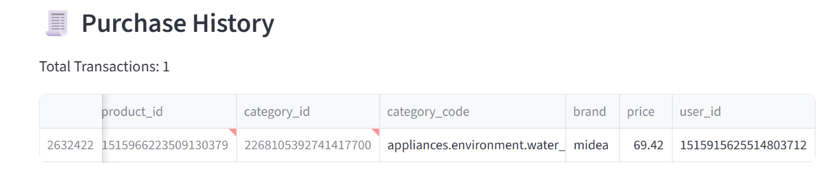
Dashboard – Customer Overview

Slide 18
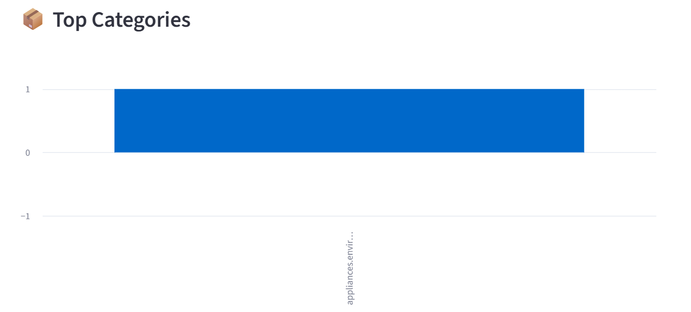
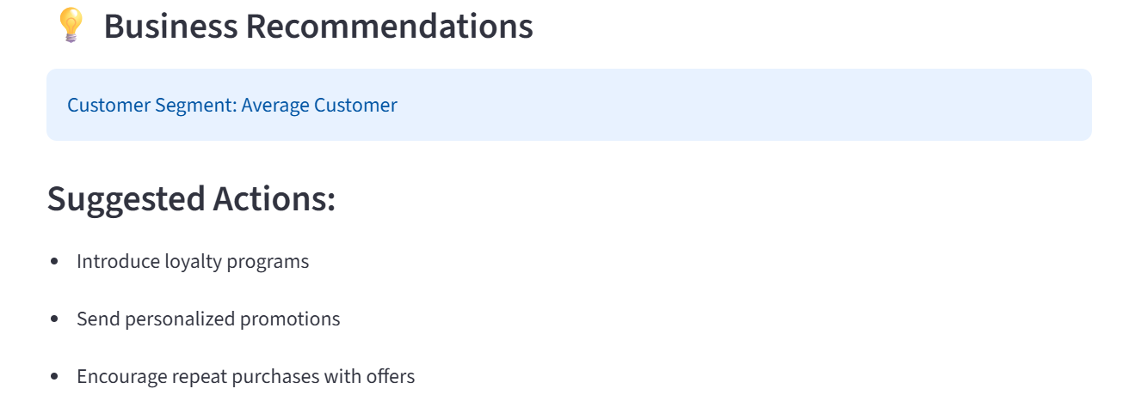
Dashboard – Customer Overview

Slide 19
Integration of ML Model with Dashboard
RFM + KMeans model output stored as CSV
Streamlit reads:
final_rfm_clusters.csv
transaction dataset
Real-time filtering based on customer ID
Dynamic computation of metrics (Monetary, Frequency)

Slide 20
Conclusion
Cluster 0: Low Potential Customers
Description: Medium recency, low frequency, and low monetary value.
Interpretation: Not very engaged with the platform, unlikely to make frequent or high-value purchases.
Cluster 1: New Customers
Description: High recency, low frequency, and low monetary value.
Interpretation: New to the platform, still exploring products or services.

Slide 21
Conclusion
Cluster 2: High-Value Customers
Description: Respectable recency, high frequency, and high monetary value.
Interpretation: Valuable customers making frequent and high-value purchases.
Cluster 3: Average Customers
Description: Medium recency, frequency, and monetary value.
Interpretation: Moderately engaged with the platform, moderate frequency, and spending level.
Interactive dashboard enables real-time customer insights
Helps businesses take data-driven decisions instantly

Slide 22
Business Impact & Benefits
Personalized marketing
Improved customer retention
Better revenue targeting
Scalable solution using PySpark + Streamlit

Slide 23
THANK YOU

